Slide 1
PREDICTING THE E NERGY OUTPUT OF WIND TURBINE BASED ON WEATHER CONDITIONS
BY ABHISHEK PRASAD

Slide 2
OVERVIEW
AS OUR TRADITIONAL POWER SOURCES ARE RUNNING OVER NATURAL RESOURCES AND THEY ARE EVEN POLLUTING OUR ENVIRONMENT .
MOST OF COUNTRIES ARE STARTED INVESTING IN WIND ENERGY AND IT IS GROWING. BUT WE CAN’T ALONE DEPEND ON WIND ENERGY SINCE IT IS COMPLETE DEPENDS ON NATURE.
SO WE CAN MAKE A TIME SERIES MODEL WHICH CAN PREDICT IN FUTURE THAT HOW MUCH ENERGY WILL BE PRODUCED USING SOME INDEPENDENT FACTORS LIKE WIND SPEED AND DIRECTION AND ACCORDING TO THIS OUR TRADITIONAL SYSTEMS DOESN’T OVER PRODUCE.

Slide 3
TECHNOLOGY STACK
IN THIS WE HAVE USED
FLASK
BOOTSTRAP
HTML
PLOTLY
IBM CLOUD SEVER
IBM DATABASE
WEATHER API

Slide 4
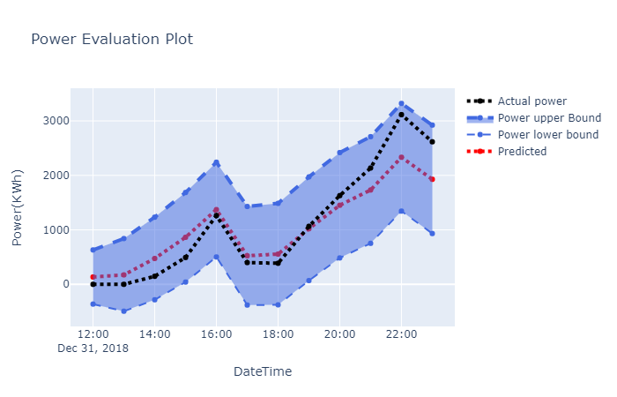
RESULTS

Slide 5
RESULTS
RMSE IS 369 KWH.
IT PREDICTS THE OUTPUT OF 95% CONFIDENCE INTERVAL.
FROM STATISTICAL TEST DATA IS STATINONERY
IT HAS NO SEASONALITY
IT HAS AUTOCORRELATION

Slide 6
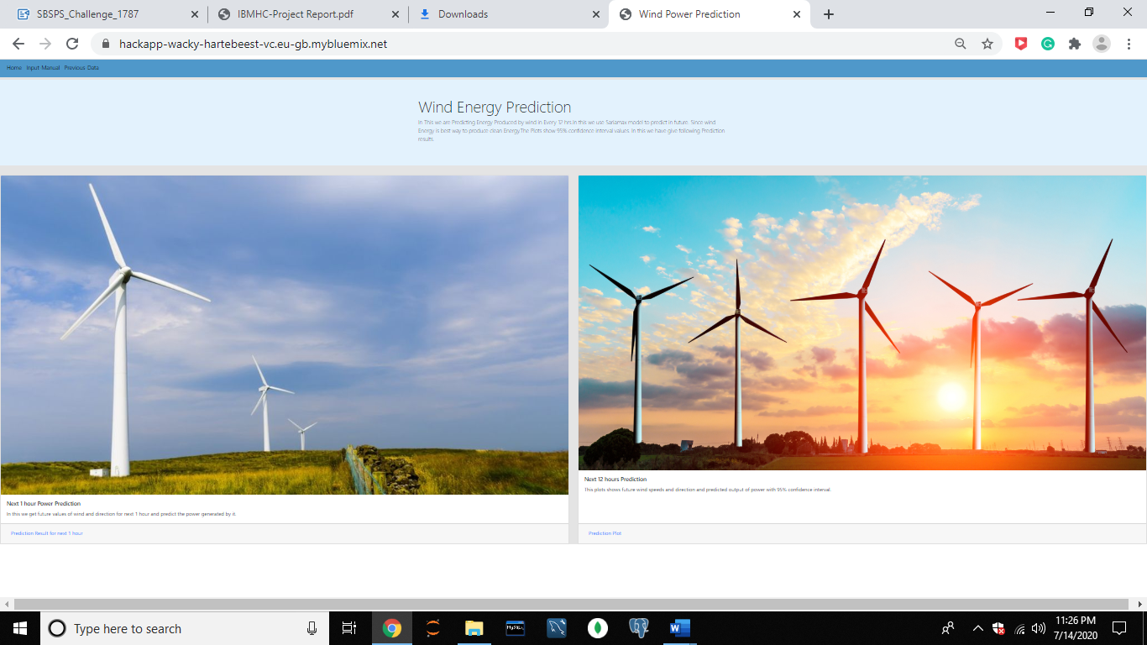
WEBSITE SLIDES

Slide 7
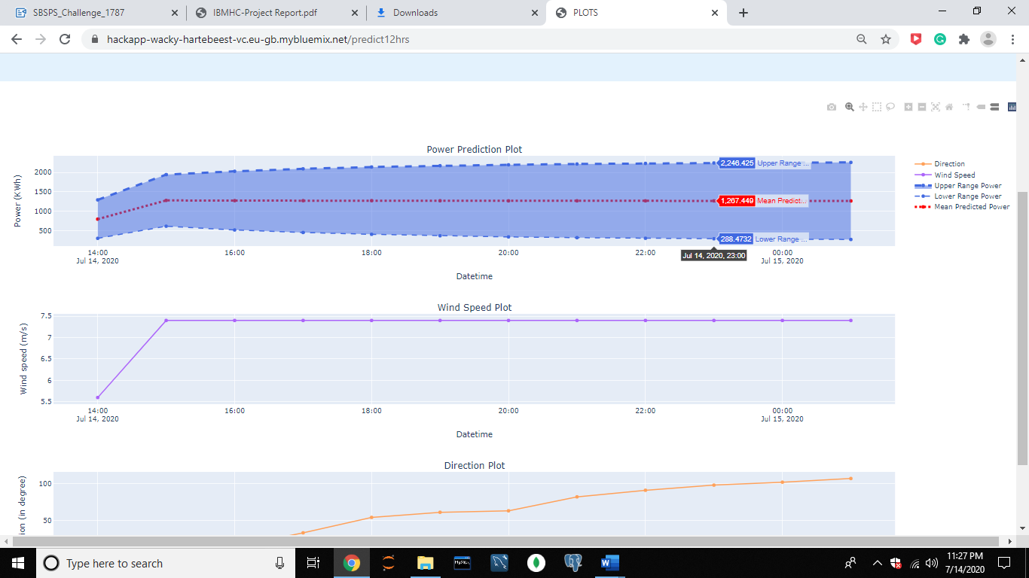
WEBSITE

Slide 8
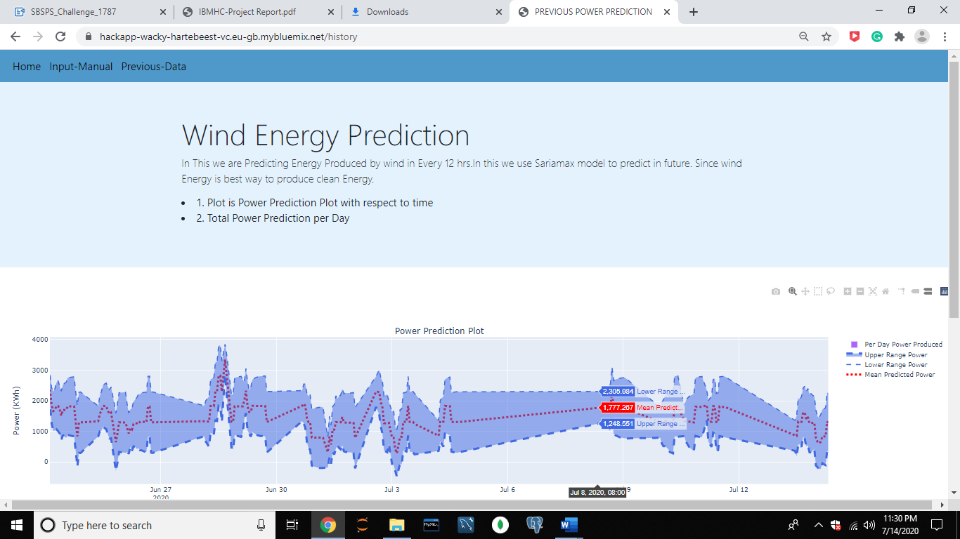
WEBSITE

Slide 9
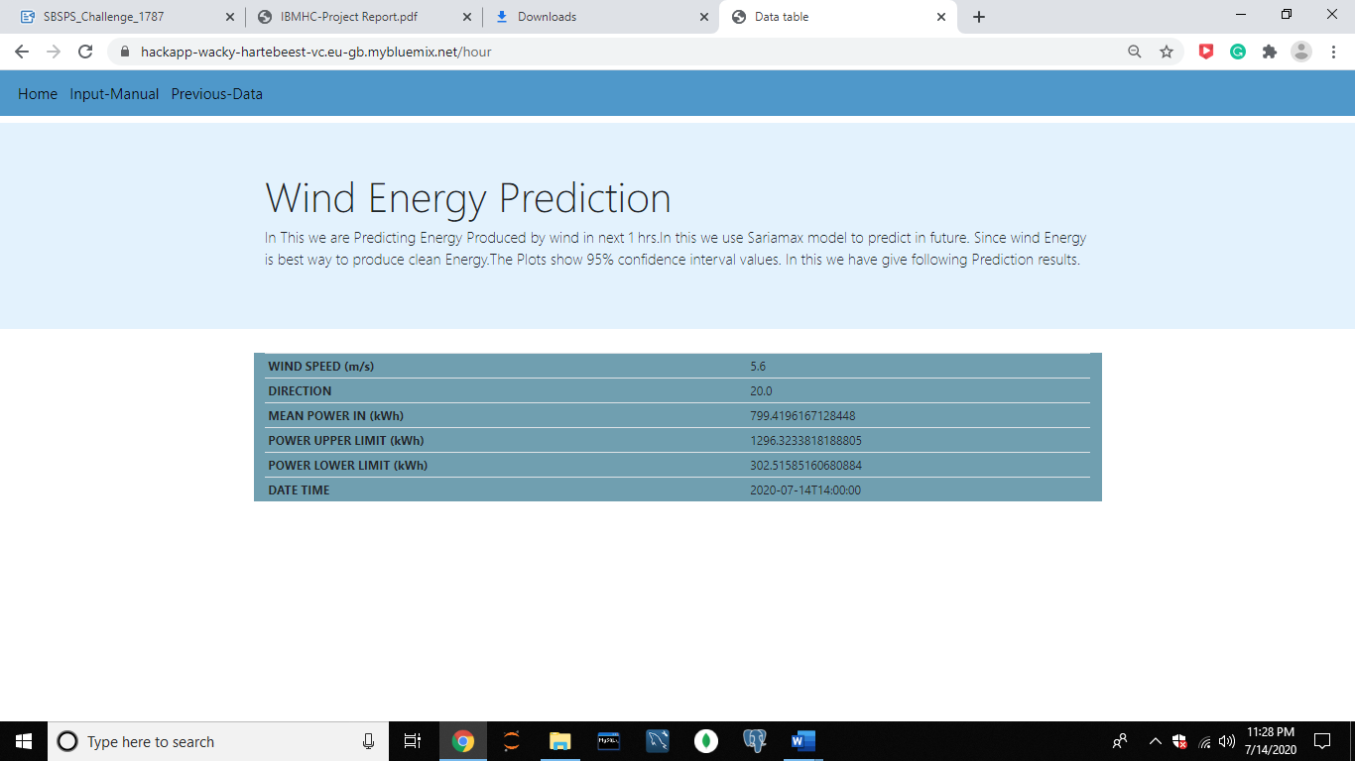
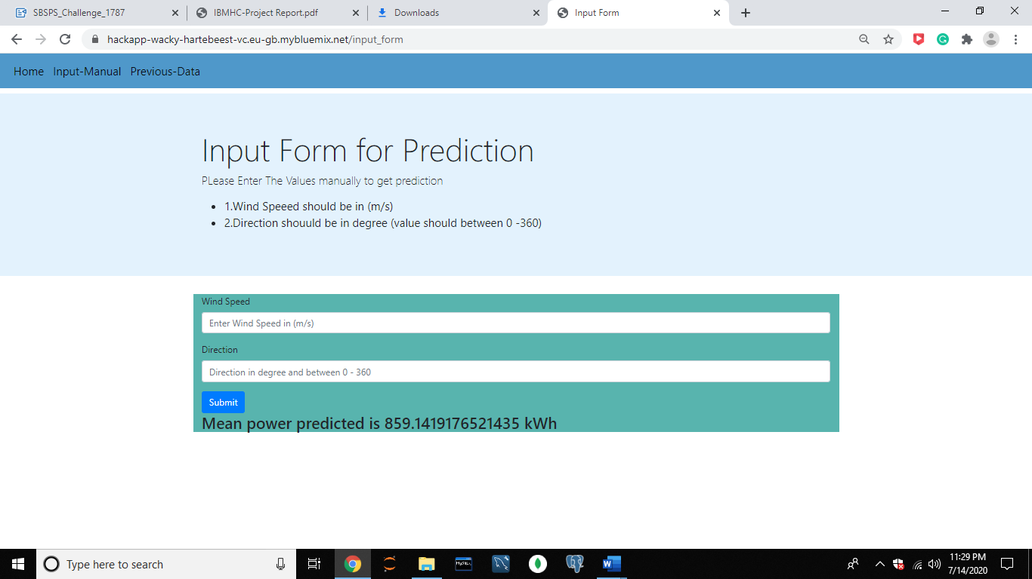
WEBSITE

